Slide 1
The Purpose of Valuation
Our Disclaimer: It’s pretty simple, don’t mistake this lecture for financial advice. Our lawyer would say: The information presented is general information only for the purposes of education, and does not constitute financial advice. This information does not take into account your investment objectives, particular needs or financial situation. Always consult a licensed and trustworthy professional before making a financial, taxation or legal decision.
www.raskfinance.com
Notes:
Hi Everyone, it’s Owen from Rask Finance. Visit us at www.raskfinance.com for all the content in this video, plus our latest tutorials and courses.
This is the second tutorial in our series the Value of Everything. It’s a free online course that will help you understand why and how analysts and investors calculate the value of all types of businesses, stocks, assets and more.
This is the second tutorial. In it I’ll quickly discuss what valuation is and what the best investors are looking to find.
First, our disclaimer…

Slide 2
Two Value Terms
Intrinsic Value (aka “price target”)
Asymmetric Return
www.raskfinance.com

Slide 3
1. Intrinsic Value (IV)
The number we calculate with a valuation model.
It represents the worth of something, like a stock.
The intrinsic value you calculate maybe different to the value that I calculate.
There is no way of knowing immediately who is correct. Both of us may be wrong.
www.raskfinance.com
Notes:
The final number we calculate with a valuation model.
It represents the worth of something, like a stock.
We calculate the intrinsic value using a model.
But remember models may not work in real life.
Modelling something does not mean it is correct!
Finallly…(change slide)

Slide 4
1. Intrinsic Value (IV)
IV is different from price!
www.raskfinance.com
Notes:
IV is different from price!

Slide 5
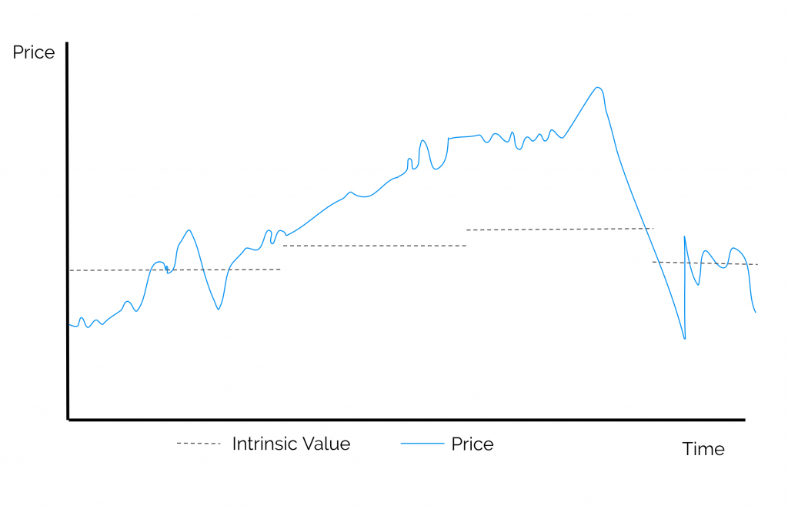
1. Intrinsic Value (IV)
www.raskfinance.com
Notes:
Here’s a chart from our website. It shows the value of some asset, with a dotted grey line; and its price, with a blue line. As you can see the price of this investment moves around a lot, in fact it changes every day. The value of this asset does not fluctuate as often. It changes, but not nearly as frequently the price. That’s because the valuations we create is based on the asset’s fundamentals.
Think about it as if you were valuing your local coffee shop. If you valued it today, would you value it tomorrow, and the next day and the day after that? You wouldn’t.
You would only value it when something changes with the business or if you learn something new.
Notice also that the price and the value can move away from each other at times, sometimes by a widen margin. That’s normal.

Slide 6
1. Intrinsic Value (IV)
If the Intrinsic Value is greater than the price of the asset we say it is “under valued”.
For example, if we value Apple stock at $200 but it is priced at $150.
We would say it is “undervalued”.
If we value Apple at $100 and it is priced at $150, we would say it is “overvalued”.
If the price equals the intrinsic value we say it is “fair value”.
www.raskfinance.com
Notes:
If the Intrinsic Value is higher than the asset we say it is “under valued”.
For example, if we value Apple stock at $200 but it is priced at $150.
We would say it is “undervalued”.
If we value Apple at $100 and it is priced at $150, we would say it is “overvalued”.
If the price equals the intrinsic value we say it is “fair value”.

Slide 7
1. Intrinsic Value (IV)
Remember, valuations are just models.
And we all make mistakes in models.
So, it is better to be generally right than specifically wrong.
www.raskfinance.com

Slide 8
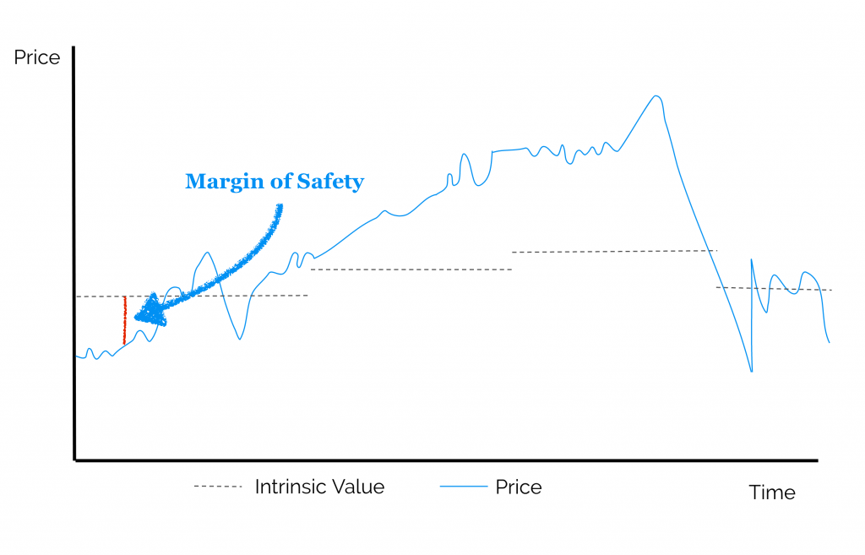
1. Intrinsic Value (IV)
www.raskfinance.com
Notes:
That’s why we have something called the margin of safety. This is the difference between our calculated value and market price. Shown here with a red line.
It is also known as the margin of error because it adjusts for us making a mistake in our research and/or our valuation.
Note to readers: I explained Margin of Safety terribly! So if you want more information on the topic or more – better – detail please send me an email: owen@raskfinance.com, or hit me up on Twitter: @owenrask.

Slide 9
2. Asymmetric Return
$110
+
$100
-
$90
www.raskfinance.com
Notes:
Next up we have the concept of asymmetric return. Don’t let the name fool you.
Let’s say you are valuing Apple shares today. It’s priced at $100. And you want to invest in it.
Anything above the white line on this page is profit (+) and anything below the white line is a loss (-)
You conduct your valuation and find that Apple is worth either $110 or $90 per share depending on whether it’s latest device is a success. Both outcomes are equally likely.
So, if you buy Apple shares today, you will either lose $10 or make $10 in profit. Would you make the investment?
You wouldn’t. Because even if your valuation is correct the risk is the same as the reward.

Slide 10
2. Asymmetric Return
Good investors want the potential return to be greater than the risk.
In other words, an asymmetric return.
www.raskfinance.com
Notes:
The best investors always want the profit potential to be greater than the loss.
In other words, an asymmetric return profile.

Slide 11
2. Asymmetric Return
$150
+
$110
$100
-
$90
www.raskfinance.com
Notes:
Returning to our example, let’s say you are valuing Apple shares again. It’s still priced at $100. (click)
This time you conduct your valuation and find that it is worth either $90 (click)(click), in the worst situation, $110 (click)(click), if the new device is received well, or $150 (click)(click) if the latest device is a hit. Each outcome is equally likely.
So, if you buy Apple today, you will either lose $10, make $10 in profit or $50 in profit. Would you make the investment?
The answer is you would. Because if your valuation is correct, the potential returns (click) greatly outweigh the risk. (click)
These are the types of investments the best investors are trying to uncover. They know they won’t get it right every time, but if they consistently take risks with greater return potential, they expect to do well investing money over time.

Slide 12
Next time
No more slideshows!
We will start creating our valuation models, including:
Discounted Cash Flow (DCF)
Dividend Models
EPV, and more
www.raskfinance.com
Notes:
That concludes this primer on valuation. And it is the last slideshow in the series (hooray!).
In the next videos we will start creating our valuation models, including:
Discounted Cash Flow (DCF) analysis
Dividend Models
EPV, and more

Slide 13
Find us
If you have any questions, find me Twitter:
@owenrask
Visit us online at:
raskfinance.com
@raskfinance
www.raskfinance.com
Notes:
Remember if you have any questions, find me on Twitter with the handle @owenrask or with @raskfinance.
Also, you can access this slideshow online by visiting us at raskfinance.com, where we have many more courses, podcasts and tutorials.

